Slide 1


2026 FALL PRODUCT PROGRAM TRAINING
$912,546 was sold last fall through our council’s program to benefit Girl Scouts.
Notes:
Recording: ”Welcome to the Product Program training for Service Units. Thank you for taking the time out of your busy schedule to learn more about and prepare for the upcoming program. The last campaign was a successful program for our council with overall direct financial benefit going back to Girl Scouts within the council. Each Girl Scout participating significantly contributed to the troop and council funding to support their activities.
If you served in this role last year, you helped keep the Product Program story relevant and assisted in motivating troops and Girl Scout participants to achieve their goals. If you are new, welcome aboard and get ready for an incredible Product Program.”

Slide 2




5 SKILLS ACQUIRED THROUGH GIRL SCOUT LEADERSHIP EXPERIENCE
Goal Setting
Money Management
People Skills
Decision Making
Business Ethics
Plus: Girl Scout Programs, Camp, Troop Activities & Giving Back
Notes:
Recording: “So why Product Programs? The Product Program reinforces the 5 skills acquired through the Girl Scout Leadership Experience including Goal Setting, Money Management, People Skills, Decision Making and Business Ethics. Participation allows Girl Scouts to not only learn valuable life skills, but progressively build an entrepreneurial mindset, preparing them for future business opportunities and leadership roles. Plus, Girl Scouts directly benefit since their participation helps to support Girl Scout Programs, camp, troop activities and giving back to their communities. That’s their why. What’s your why? Take a moment to reflect on how you have seen participants benefit through Product Programs.”

Slide 3
YOUR IMPACT ON THE
GIRL SCOUT’S EXPERIENCE
The Program itself is a learning experience
Troops use money earned from the program participate in fun adventures like travel and camp
Troops use money earned to give back to their community
The program helps fund the entire Girl Scout Experience
Notes:
Recording: “You are directly impacting the future of Girl Scouts by:
–Facilitating this Girl Scout-led entrepreneurial program
–Assisting Girl Scouts in earning money to support their amazing Girl Scout-led adventures
-Enabling troops to give and serve locally, nationally and globally
–Providing Girl Scouts with the opportunities to share their skills to make the world a better place.”

Slide 4











Are you…
Notes:
Recording: “As we get ready to dive into this year’s program details, I would ask you: are you… Ready to Explore? This year, we’re embracing a spirit of curiosity, adventure, and forward momentum as we help Girl Scouts discover new opportunities, build skills, and reach their goals. As volunteers, you play a vital role in guiding Girl Scouts through a fun, simple, and successful fundraising experience, and we’re excited to have you with us as we jump into another impactful season together.”

Slide 5

KANGAROO
Lives in Eastern Australia in small groups called “troops”
Use their strong tails for balance while jumping
Newborn joeys are just 1 inch long (2.5cm) at birth (size of a grape)
Female Kangaroos sport a pouch on their belly to cradle joeys
Notes:
Recording: “Our theme animal—the kangaroo—represents energy, progress, and big leaps forward, perfectly reflecting what this program is all about. Kangaroos live in Eastern Australia in small groups called troops. They use their strong tails for balance while jumping. Female Kangaroos sport a pouch on their belly to cradle baby joeys. Newborn joeys are just 1inch long at birth and are about the size of a grape.”

Slide 6


TROOP PROCEEDS
15% – Troop proceeds
New Opt-Out Option
  Troops will be able to decide to forgo all rewards (except for patches) and earn an additional 2% in troop proceeds.
  The decision needs to be made at the troop level and can be changed during the program, but the decision will be for all girls.
  Not available for IGMs due to system limitations.
Notes:
Recording: “Girl Scout goals work in tandem with the troop’s financial goals. Encourage troops to use some time during their troop meeting to map out their troop’s collective goals for this coming Girl Scout program year. Use those goals to create a troop budget. Work with participants to set both individual goals and show how each Girl Scout contributes toward reaching the troop goal. Specific details regarding proceeds for nuts and magazines are here. Fall Product Program is an easy way to earn startup funds and begin to meet the troop’s goals for the year.”

Slide 7





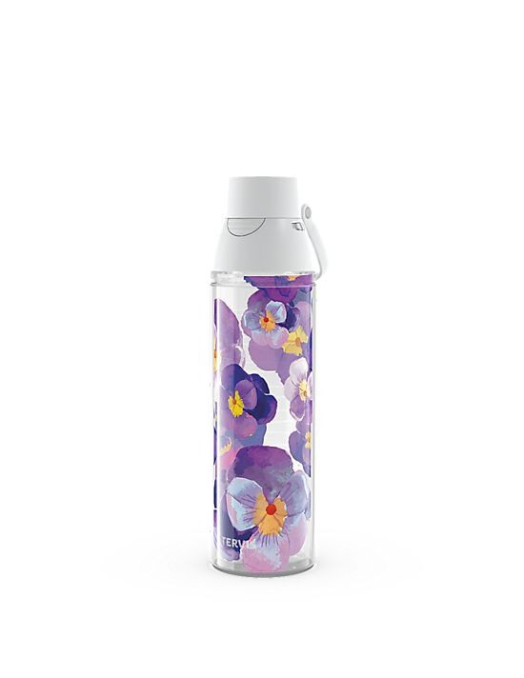
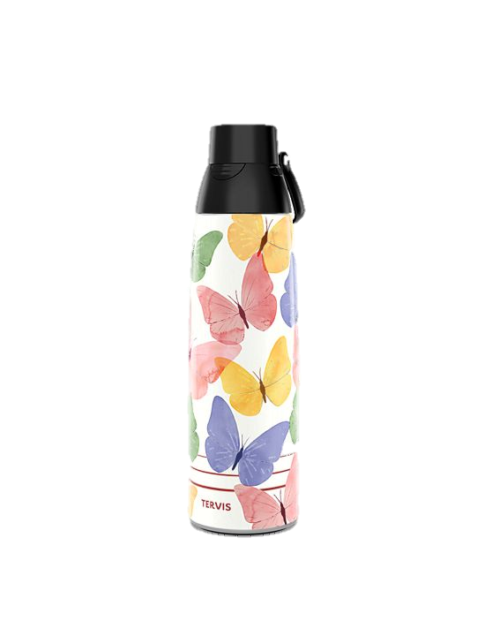
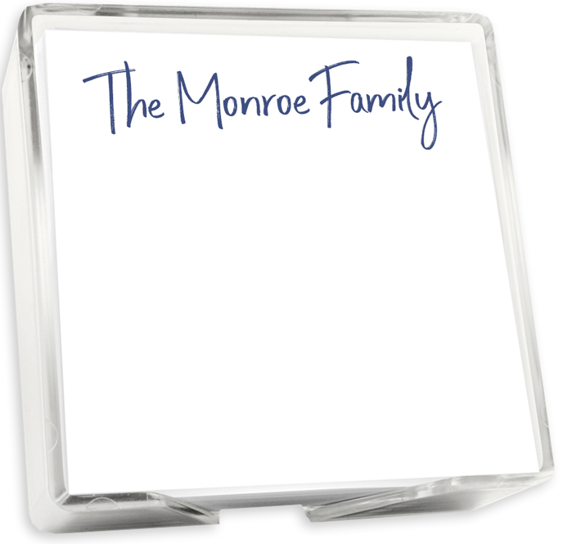
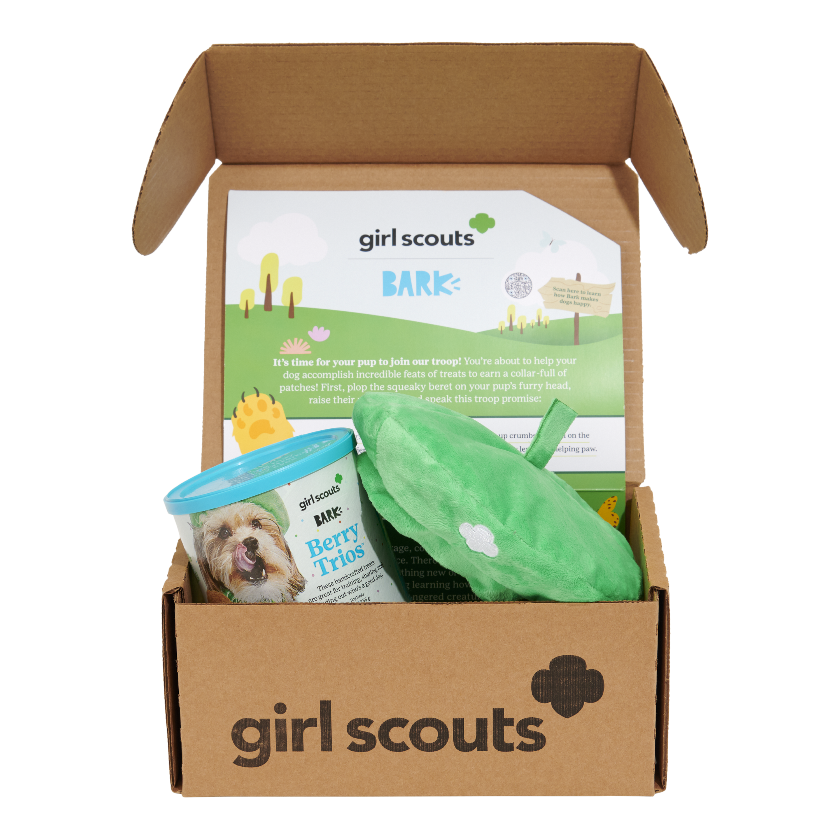

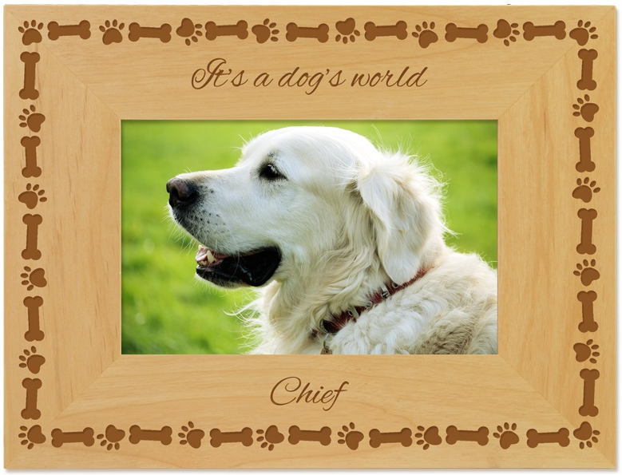
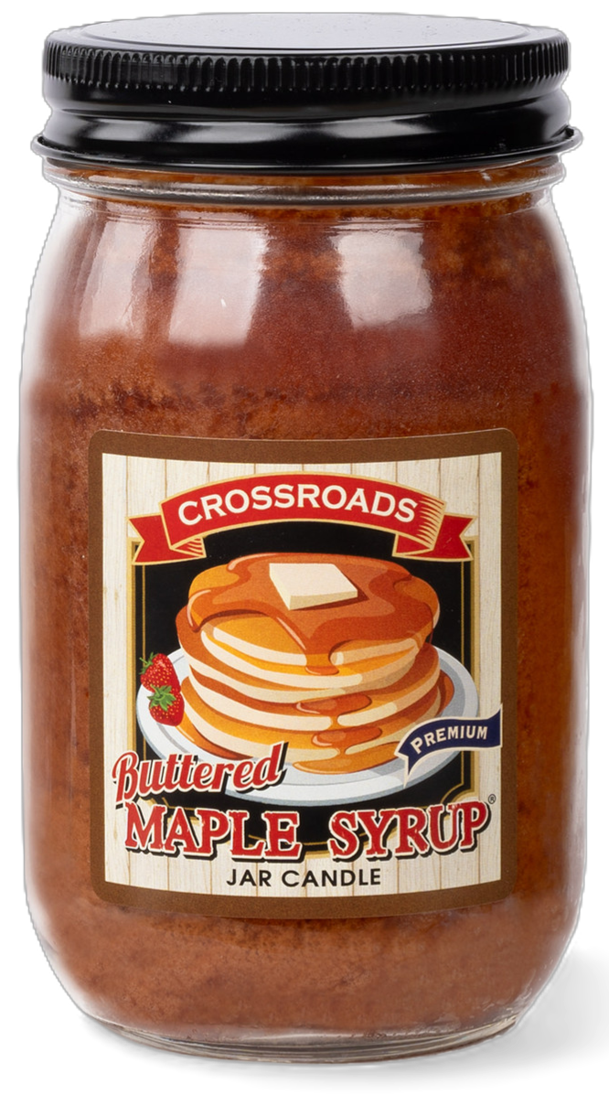
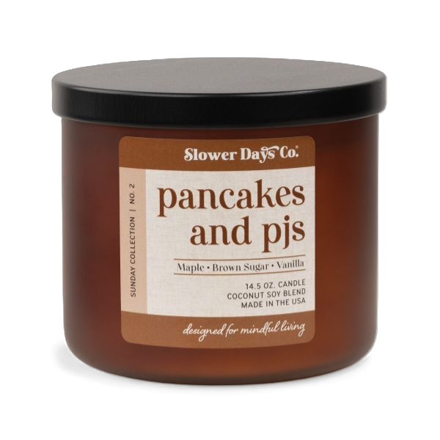
FALL PROGRAM PRODUCT LINES
Nuts & Chocolates
Magazines
BarkBox
Candles
Personalized Products
Tervis Tumblers
Notes:
Recording: “During the Fall Product Program, supporters can choose from a wide variety of products, including Nuts & Chocolates, Magazines, BarkBox, Candles, Personalized Products, and Tervis Tumblers. All purchases support Girl Scouts in reaching their goals. All product options are available online with additional options to purchase nuts & Chocolates in person.”

Slide 8
END OF MODULE #1
(QUESTIONS FOR GSLEARN)
1.Which of the following are not one of the skills pursued through product program?
A. Goal Setting
B. Money Management
C. People Skills
D. Not Following Through
E. Business Ethics
2.TRUE OR FALSE - Before the beginning of the Product Program, you should take time to ask each Girl Scout their “why” and work with the Girl Scouts as a troop to help them feel comfortable sharing their purpose and goals with supporters.
3.The campaign’s theme mascot is the:
A. Asian Elephant
B. Grizzly Bear
C. Kangaroo
D. Spinner Dolphin
4.Working with Girl Scout participants’ goals to develop a troop budget, what are the troop proceed amounts for the 2026 Fall Product Program?
A.10% per item
B.15% per item
C.20% per item
D.$1 per nut and $3 per magazine

Slide 9


Ordering Options
Notes:
Recording: “Now let’s dig a little deeper into the available ordering options.”

Slide 10
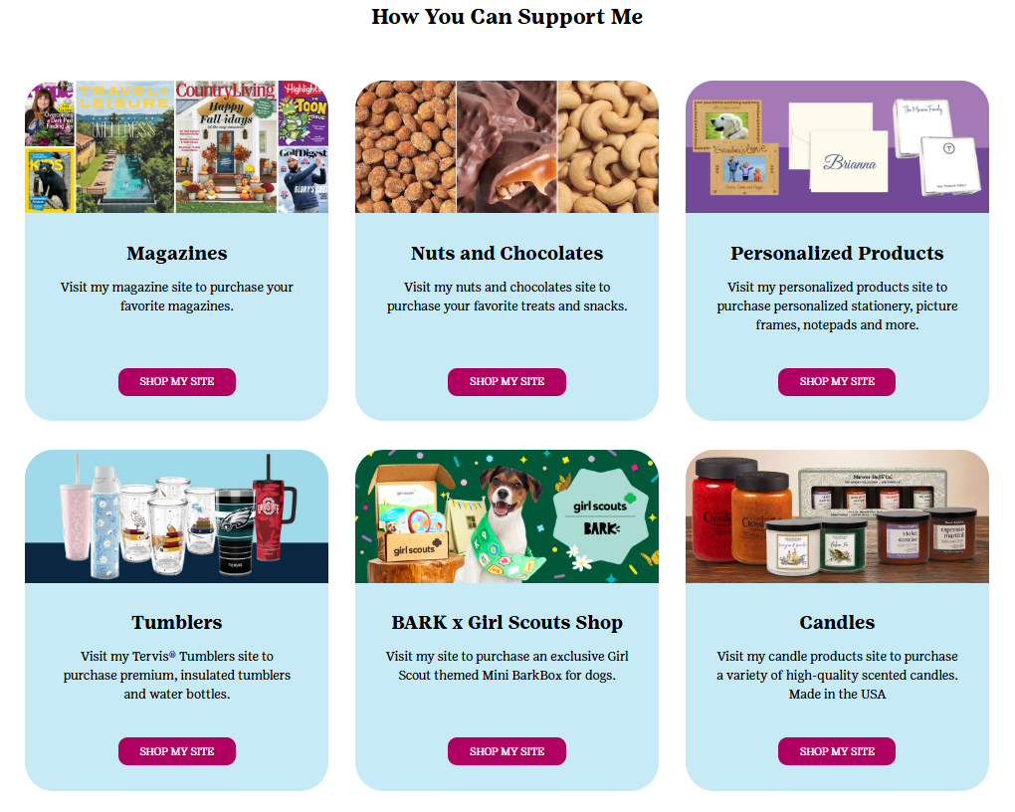
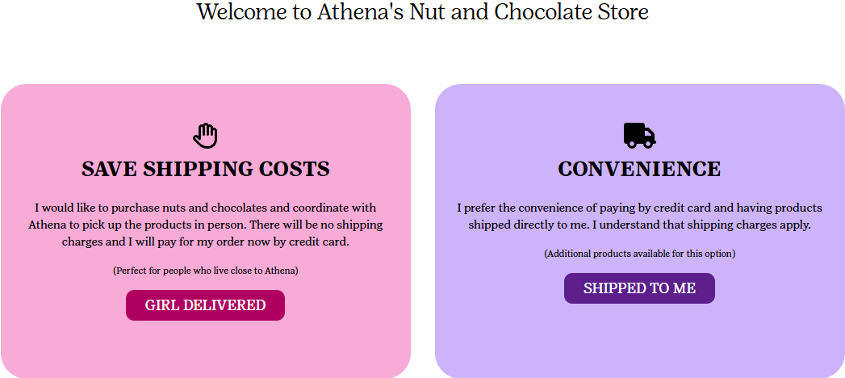
ONLINE SHOPPING SITES
Supporters enter a participant’s storefront by clicking on a link or following a QR code.
They can then select their desired product line to proceed
Nuts & Chocolates have two ordering options:
Girl Delivered or
Direct Ship
Notes:
Recording: “To access online ordering options, Girl Scouts and adults invite friends and family to make a purchase via email, social media, texting, business cards and door hangers. Supporters can then browse the available storefronts and select their online products. When selecting nuts and chocolates, supporters have the option to choose girl delivered or direct ship. Girl Scouts and adults have the option to determine which customers have the option to purchase products that participants will deliver. Therefore, some supporters will have the option of girl delivery or direct ship and others may see direct ship only. Girl delivered nuts/chocolates are those items available at council and ultimately delivered by the Girl Scout. Direct ship items are sent directly to the customer preferred address after paying for shipping. Regardless of option chosen, supporters pay for all products online at the time of checkout.”

Slide 11
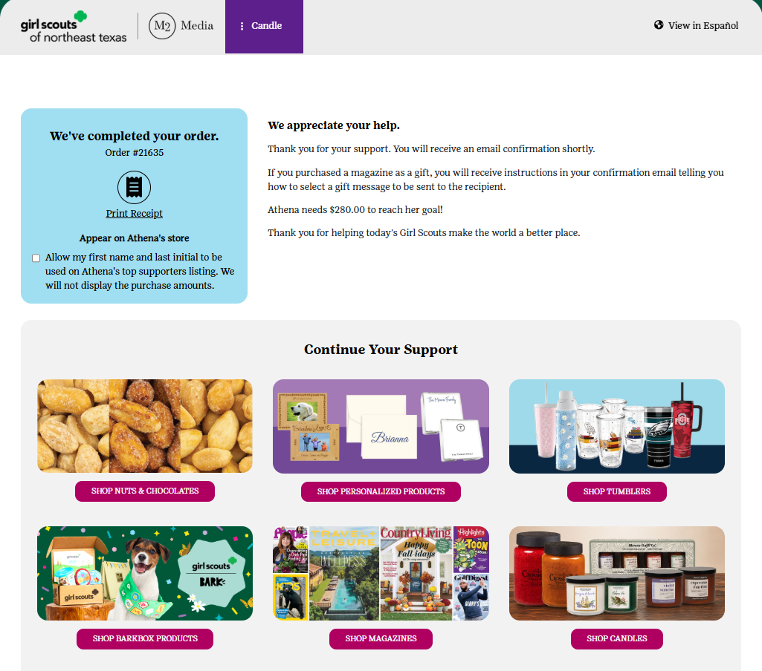
WAYS TO VISIT STOREFRONTS
Supporters can easily visit other storefronts after checking out online
Confirmation emails also include a handy link to repurchase
Notes:
Recording: “After making a purchase from one storefront, supporters can also easily select and visit other storefronts to purchase additional items of interest.”

Slide 12
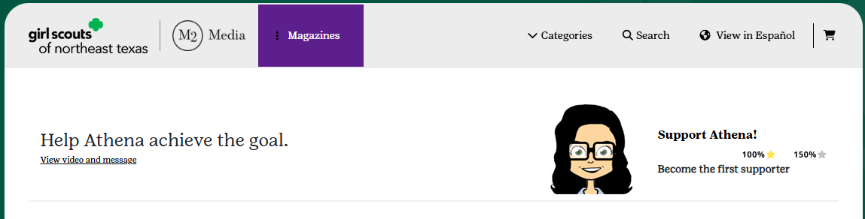
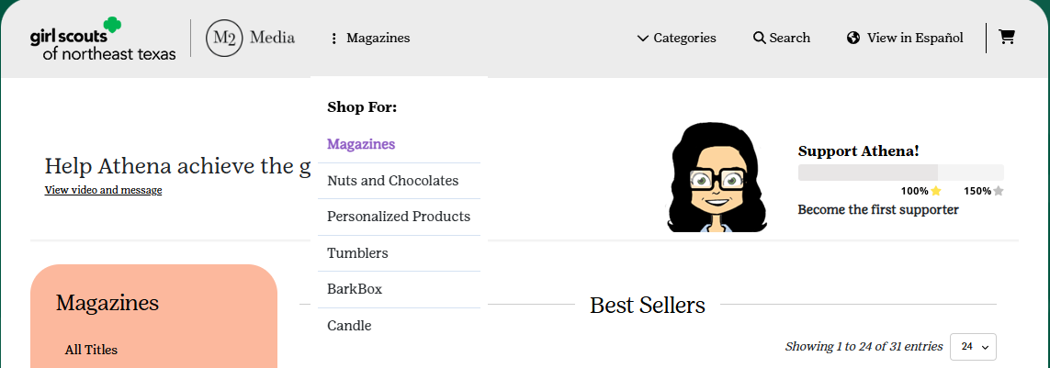
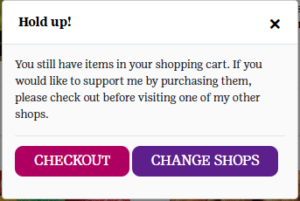
STOREFRONT UPDATE
*NEW*
This year, customers can easily toggle between storefronts using a drop-down menu
Checkout between storefronts remains separate
Notes:
Recording: "New this year, we've made it even easier for customers to shop across our different storefronts. You can now switch between available storefronts at any time using the purple button at the top of the page. Simply click the button to open a drop-down menu and select the storefront you'd like to browse. If you've added items to your cart but haven't checked out yet, you'll see a reminder before switching storefronts, giving you the opportunity to complete your purchase so you don't lose the items in your cart."

Slide 13
Nuts & Chocolates
Notes:
Recording: “Let’s learn a bit more about the Nuts & Chocolates Product line for this year!”

Slide 14

DELICIOUS NUTS & CHOCOLATES
Council’s Top Selling Items
Order Card/Girl Delivered
#1 – Deluxe Pecan Clusters
#2 – Dark Chocolate Caramel Caps
#3 – Peanut Butter Bears
#4 – English Butter Toffee
#5 – Dark Chocolate Peppermint Pretzels
Notes:
Recording: “Customers can also support a Girl Scout by purchasing nuts and chocolates via the nut order card. Girl Scouts are responsible for collecting payment and delivering these items to customers. Here are the items available on the nut order card for this campaign along with the top selling items in our council area last campaign.”

Slide 15

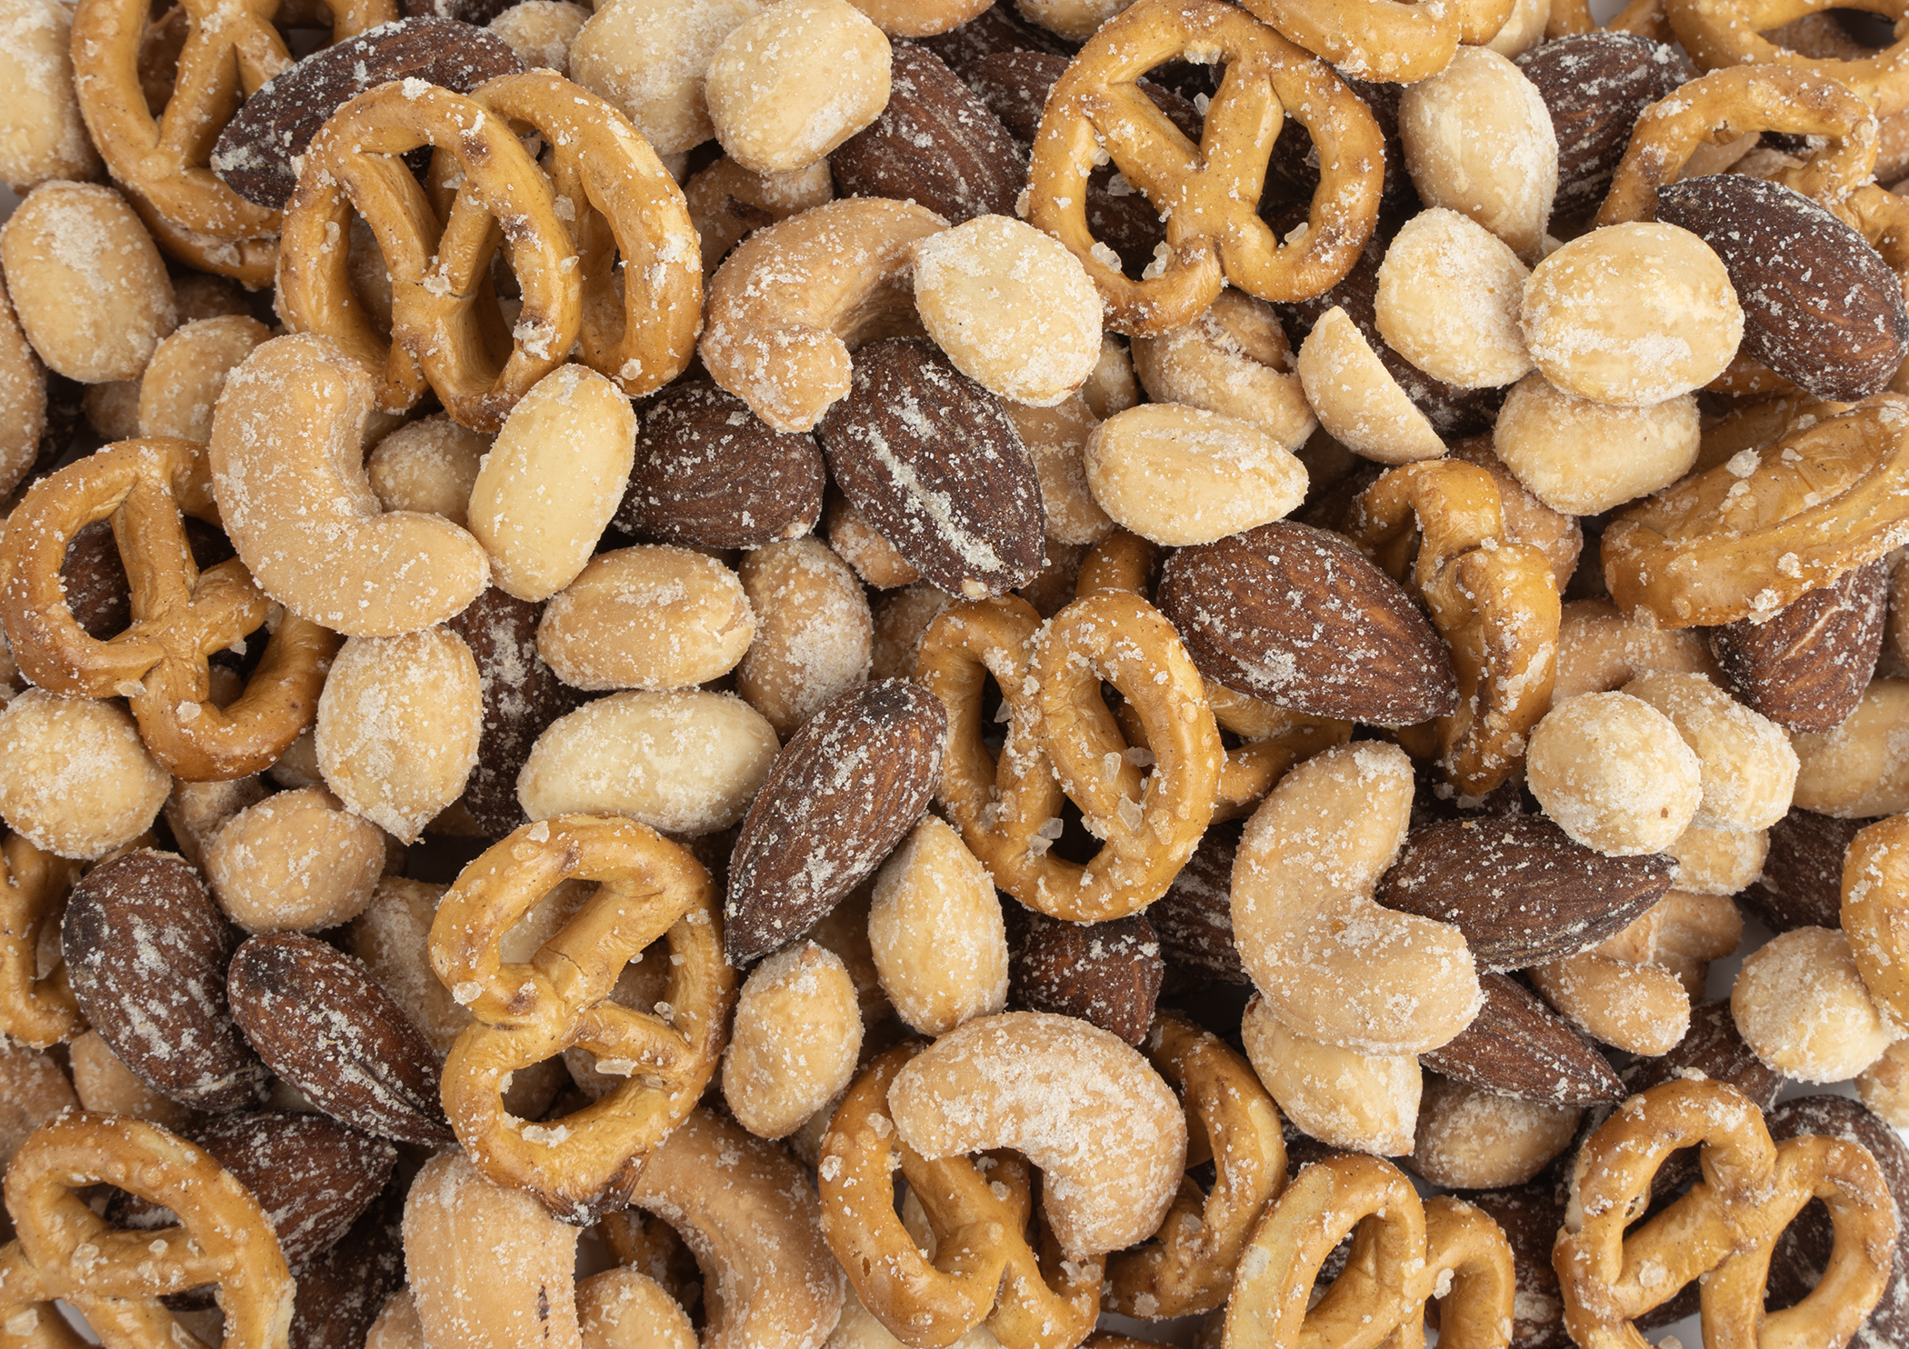
New Nut Products
Cranberry Trail
Roasted and salted Cashews and Almonds mixed in with dried Cranberries.​
​
7 oz Pop Top Can​
​
Sweet Onion Snack Mix
A blend of Peanuts, Almonds, Cashews, and Mini Pretzels – all coated in our sweet onion seasoning.​
​
8 oz Resealable Standup bag​
Notes:
AF PRODUCTS
Recording: “Highlighted here are the new items from Ashdon Farms. The original Cranberry Nut Mix has been revamped as “Cranberry Trail” - utilizing cleaner ingredients and highlighting the cranberry as the centerpiece, it also includes roasted and salted cashews and almonds. Next up is the Sweet Onion Snack Mix which includes a blend of peanuts, almonds, cashews and mini pretzels coated in a savory, tangy sweet onion seasoning.”

Slide 16
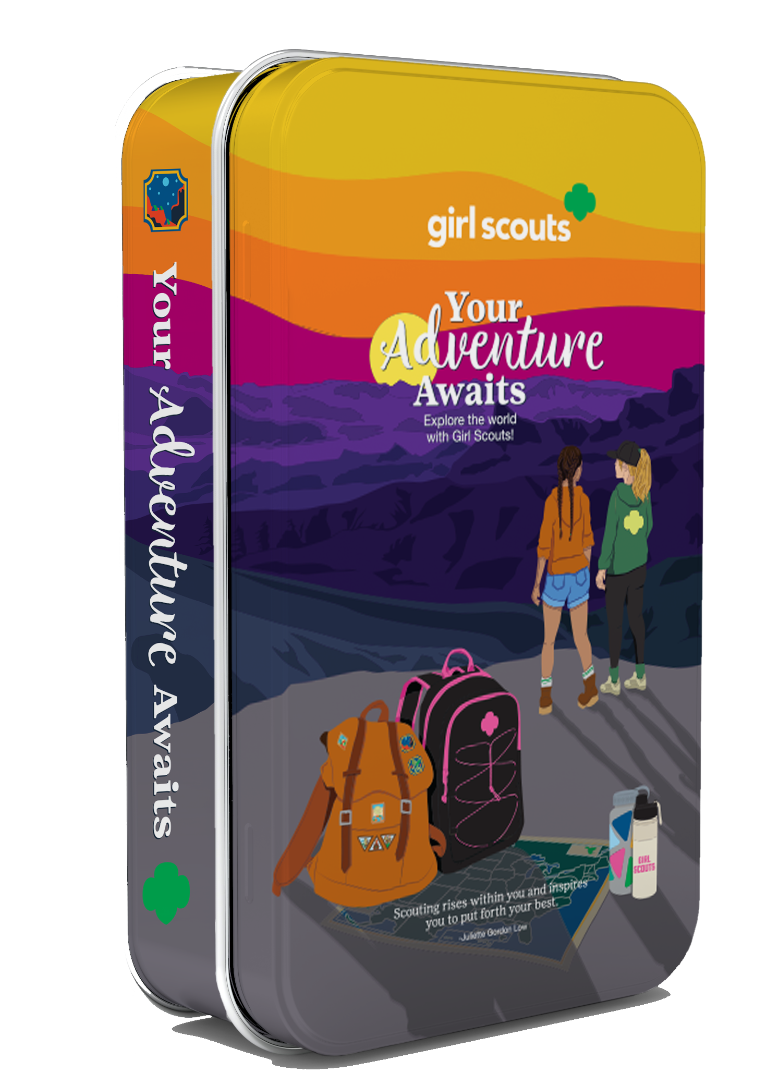

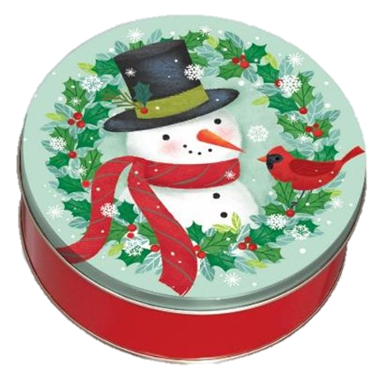
ASHDON FARMS
TINS
Perfect for Gifts and Treats!
Exploration Tin
Mint Treasures
Holiday Tin
Chocolate Covered Pretzels or Deluxe Pecan Clusters
Notes:
AF PRODUCTS
Recording: "This year's collectible Girl Scout tin is the second in our hinged, upright book-style series. Featuring a 'Your Adventure Awaits' design, the artwork celebrates the spirit of Girl Scout exploration and adventure. Also new this year is our rustic Snowman with Cardinal holiday tin, filled with delicious treats and perfect for holiday gifting or sharing with family and friends."

Slide 17
NEW Direct Ship Nut Upsell
NEW this year, when a supporter places a qualifying Direct Ship Nut & Chocolates order, they may be presented with a Bonus Offer before completing checkout. The offer appears within the shopping cart and provides an opportunity to add an additional item to their order.
Bonus Offer purchases are processed as standard Direct Ship sales and:
  Count toward participant rewards
  Count toward overall program sales
  Are fulfilled through the Direct Ship program alongside the supporter's order
  Do not impact shipping costs!
To qualify for a Bonus Offer, a supporter must have at least one non-Care to Share Direct Ship item in their cart.
Notes:
Recording: "New this year, supporters may see a Bonus Offer when placing a qualifying Direct Ship Nut & Chocolates order. Before completing checkout, they'll have the opportunity to add a specially featured item directly from their shopping cart. Any Bonus Offer purchase is treated just like a standard Direct Ship order—it counts toward the participant's rewards, counts toward overall program sales, and ships with the rest of the supporter's Direct Ship order. Best of all, adding a Bonus Offer item does not increase the shipping cost. To be eligible, the supporter's cart must include at least one non–Care to Share Direct Ship item."

Slide 18

CARE TO SHARE
Customer makes purchase to support Packages from Home
Orders can be placed through order card, online girl delivered, or direct ship channels
Product will be distributed by Council.
Troops earn proceeds and Girl Scouts earn a special patch and credit towards other rewards
Notes:
Actions:
-Update with organization(s) supported by Care to Share purchase.
-Identify any nuances to your Care to Share option.
Recording: “Supporters can give back by making a purchase to support the Girl Scout’s efforts to support their community. Orders for these items can be placed via the order card, online girl delivered or direct ship channels. Troops earn proceeds and participants earn a special patch AND credit towards other participant rewards."

Slide 19
Mags & More
Notes:
Recording: “Now we’ll explore “Mags & More”, which are the other Product lines available through the fall product program!”

Slide 20

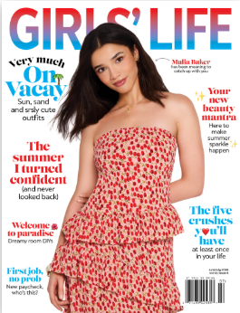
MAGAZINES
Top selling magazines
Easy renewal
*NEW*
Most popular titles returning!
Notes:
Recording: “Participants offer supporters access to top selling magazines with the online shopping option. It is easy to renew magazines while at the same time supporting their Girl Scouts.”

Slide 21


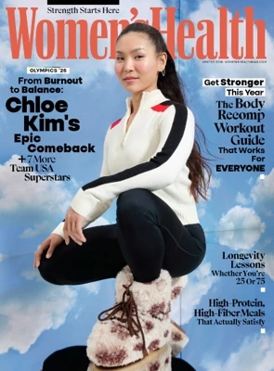
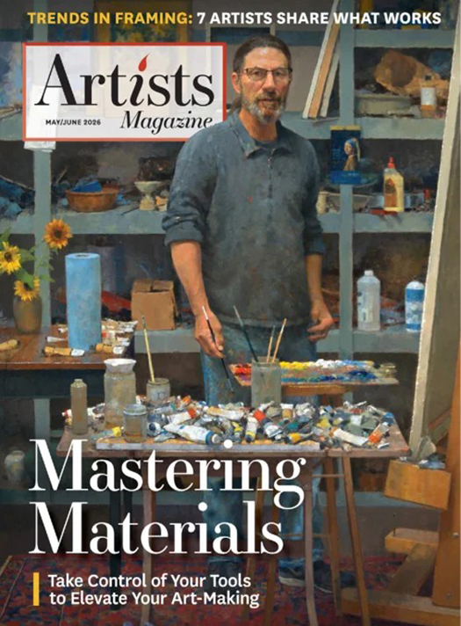


We’re excited to bring back some of our most popular titles, like print editions of…
Food Network
Good Housekeeping
Women’s Health
As well as NEW print titles expanding our special-interest categories, such as…
Artists Magazine
Love of Quilting
Watercolor Artist
Notes:
Recording: “We are so excited to reintroduce a wide variety of popular print titles back into the Magazine Storefront this year! This includes titles such as Food Network, Good Housekeeping, and Women’s Health, just to name a few! We have also been able to include some brand-new titles, expanding special-interest categories, such as Artists Magazine, Love of Quilting, and Watercolor Artist! Check out the magazine storefront to see all the great options!”

Slide 22
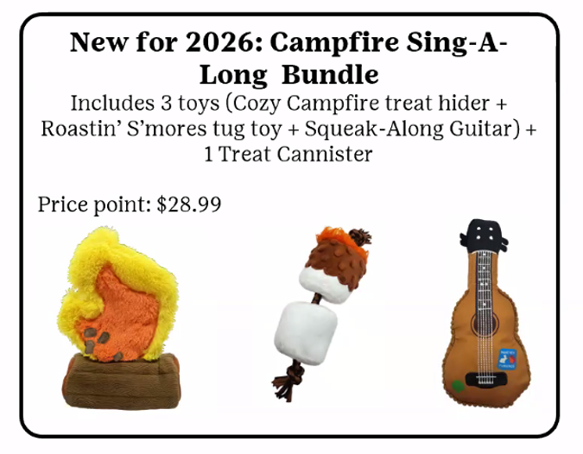
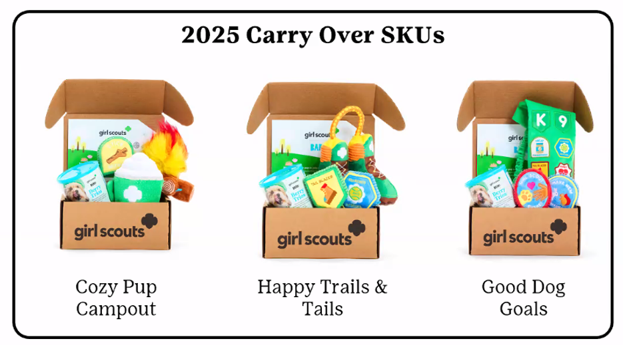
BARKBOX
Girl Scout themed BarkBox options
Choose from four different boxes!
Limited Quantity
Notes:
Recording: “Supporters can also purchase Girl Scout themed BarkBox options. The Girl Scout themed BarkBox choices allow Girl Scouts to share their passion for animals, generate troop funds for their Girl Scout activities, and gives consumers the option to purchase something for every member of their family. This year, customers can choose from 4 different themed boxes.”

Slide 23


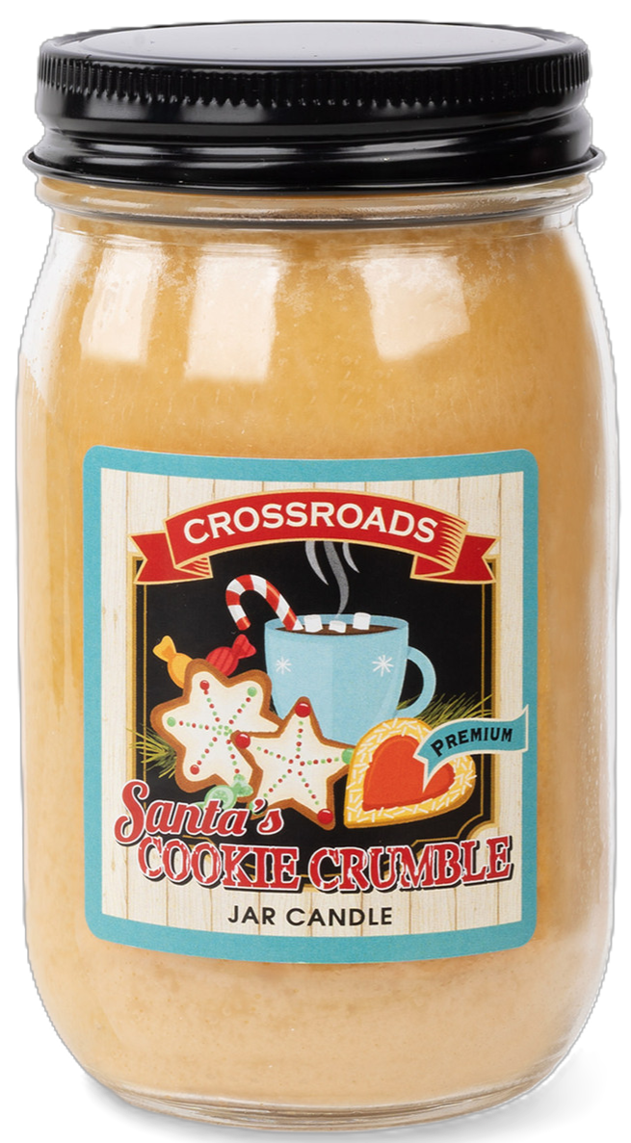

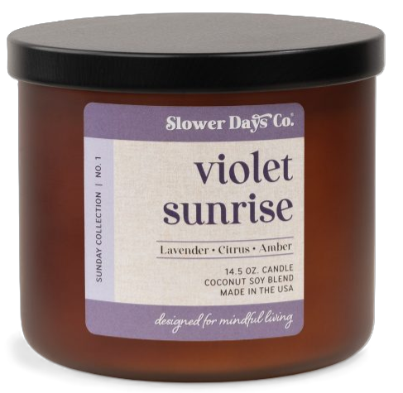
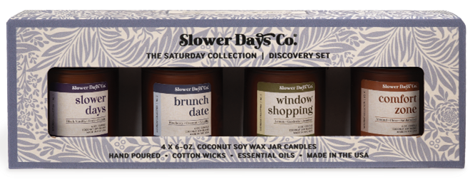
CANDLES
*New*
Original Collection:
9 fragrances
4 sizes
*New*
Coconut Soy Collection:
12 fragrances, 1 size
3 discovery sets
Styles and scents for all customers!
All new items for Fall 2026!
Notes:
Recording: “Our candle line has been completely revamped for this year! Customers will find classic style candles in 4 different sizes, with 9 different fragrance options, plus a brand-new line of coconut soy candles, in 12 total fragrances! Or, for those who can’t decide on just one scent, supporters will be happy to find 3 different Discovery Sets to choose from, which also make excellent gifts!”

Slide 24
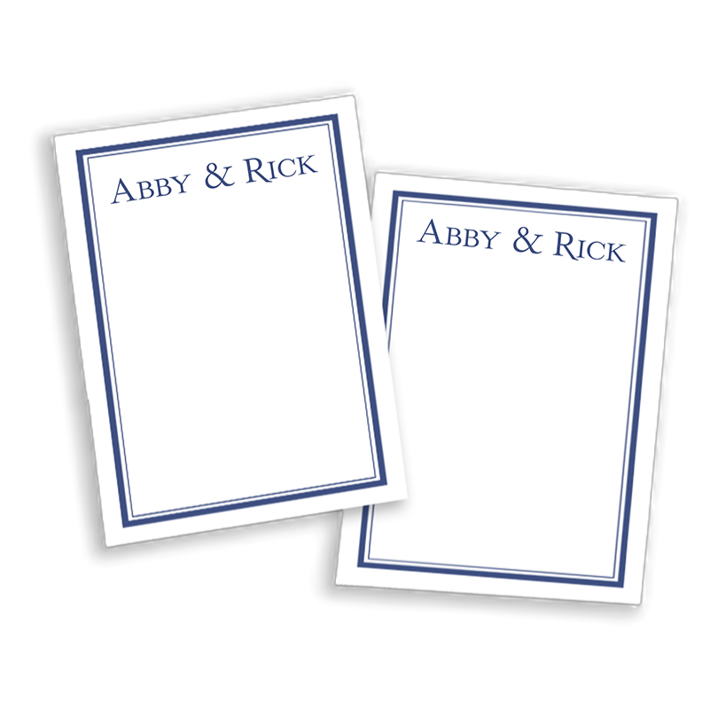
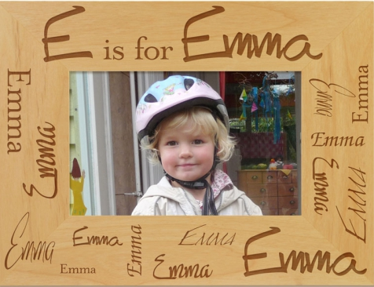
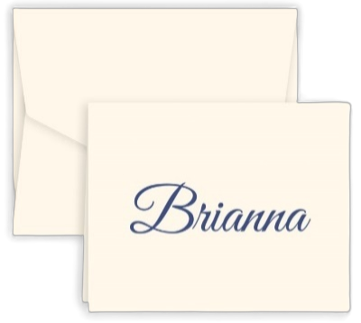
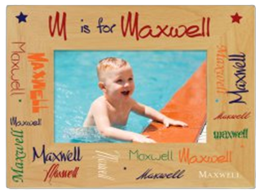
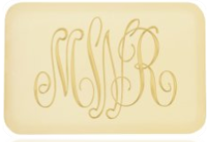
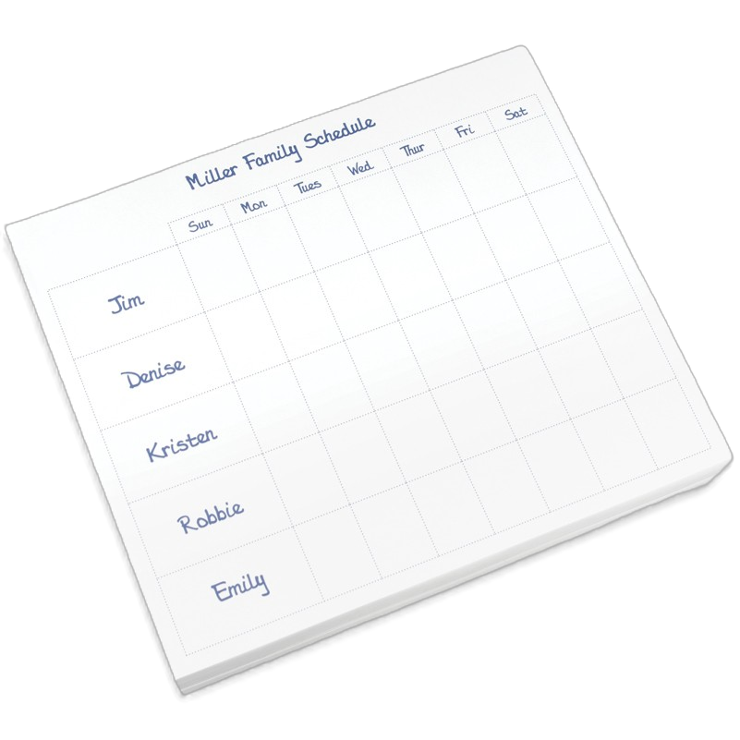
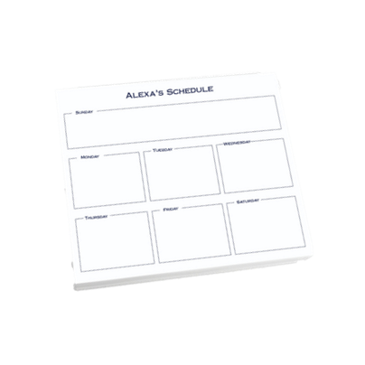
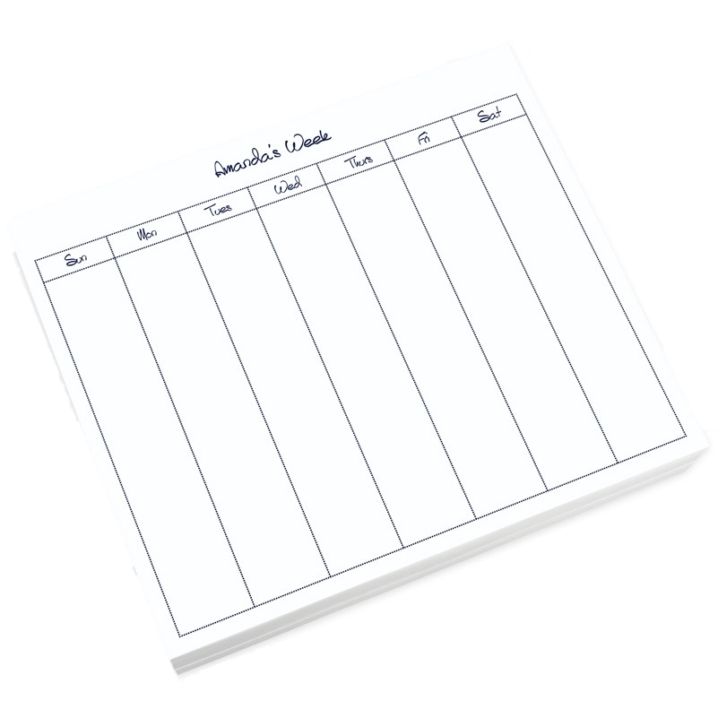


PERSONALIZED PRODUCTS
*NEW*
Personalized paper calendars, soap, colored frames, & napkins!
Notes:
Recording: "Our personalized product collection offers supporters a variety of thoughtful, customized gifts, including stationery, notepads, and picture frames. New this year, we're introducing customizable desk calendars, monogrammed soaps and candles, and elegant embossed picture frames. This elevated collection features high-quality, personalized items that are perfect for gift-giving or adding a special touch to everyday life."

Slide 25
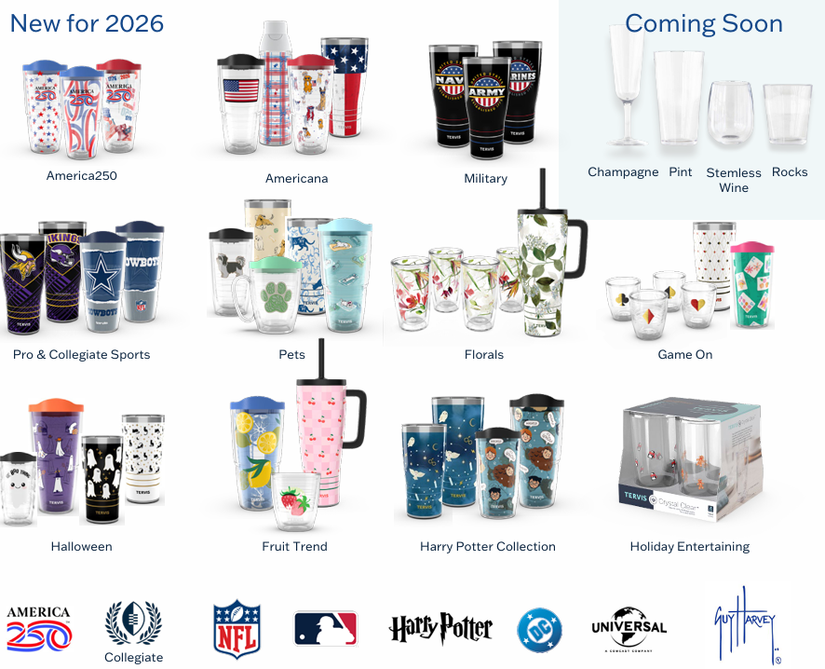
TERVIS® TUMBLERS
*NEW*
Military, America250, Halloween & more!
500+ options!
Notes:
Recording: “Supporters can choose from a wide selection of premium Tervis® insulated tumblers and water bottles, ranging from top sellers to favorite MLB®, NFL®, and collegiate sports teams and more. We have many new offerings of Tervis Tumblers, including Military, America 250, seasonal features & more. There is something for everyone in the tumblers shop!”

Slide 26

Girl Scout Experience
Notes:
Recording: “Now we’ll take some time to walk through the Girl Scouts experience and participation process.”

Slide 27
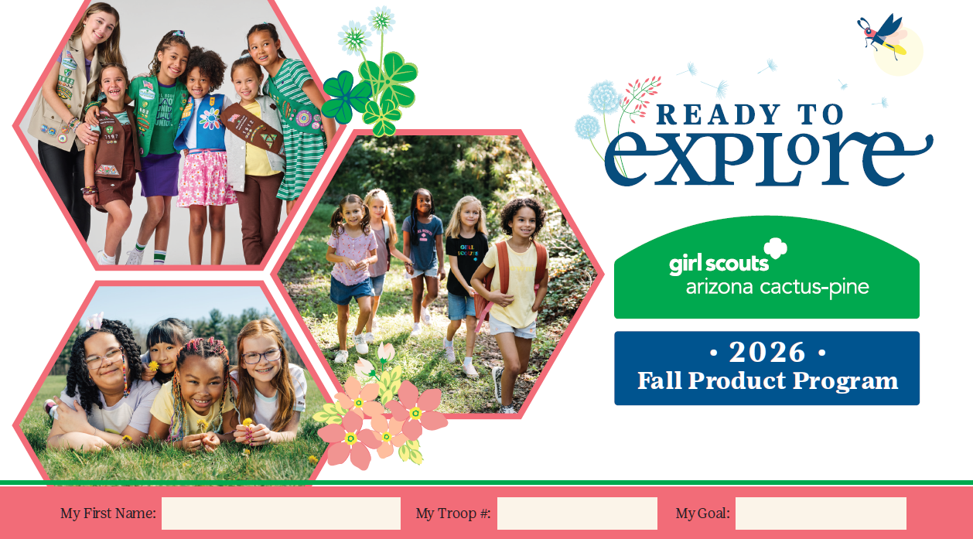
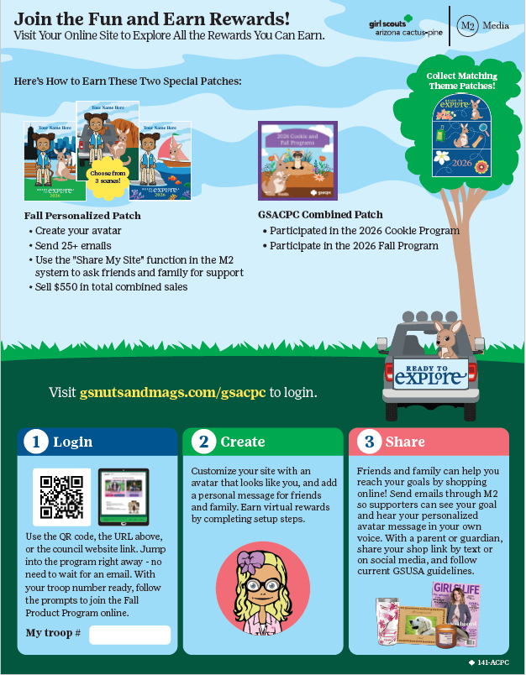
HOW TO GET STARTED
Participation is easy!
Girl Scouts can participate fully online, with access to sell nuts & chocolates, magazines, BarkBox, Candles, Personalized Products, and Tervis® Tumblers
Or, in-person with nut order card
Notes:
Recording: “Girl Scouts can participate fully by using the online platform, where they’ll have access to all product lines. Or, they can participate in-person only, by utilizing the nut order card.”

Slide 28
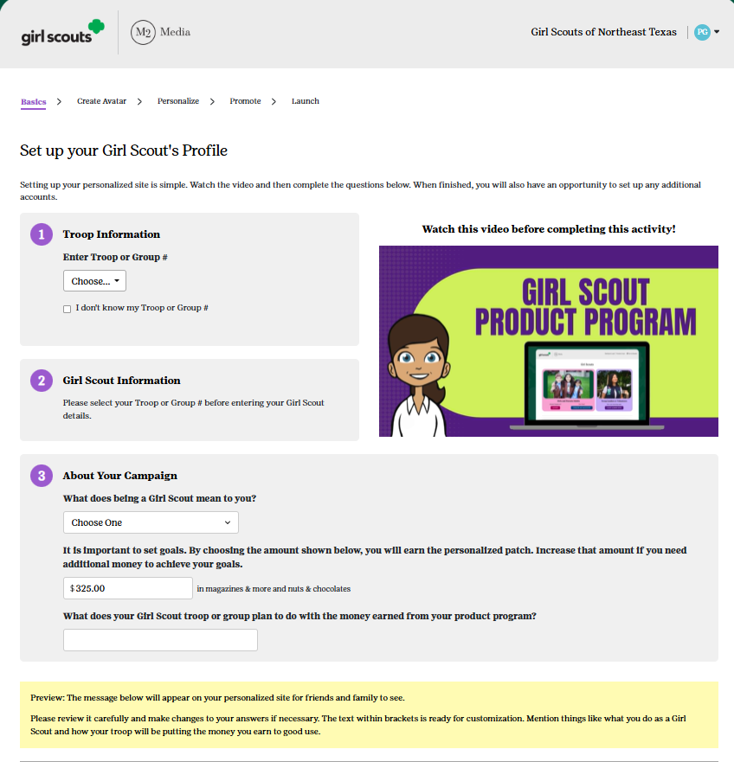
GIRL SCOUT’S PLATFORM SET-UP
Returning Participants: Login using last year’s credentials, or choose to reset your password
New Users: Choose “Create an Account” and use your preferred Email Address
Select Goals
Build an Avatar
Upload a Video
Share!
Notes:
Recording: “The parent/adult and Girl Scout login for the first time after receiving the launch email or accessing the council-specific URL on or after go day. Participants should have their troop number available. If a participant doesn’t see their troop number or name, complete the setup process and council will verify after complete. Returning participants can use the same email address and password but need to confirm and complete the setup process.
The parent/adult and Girl Scout will validate their council with their zip code, confirm their troop number, and then answer questions about their Girl Scout goals and what Girl Scouting means to them. Along the way, participants build their virtual avatar likeness with the patented Girl Scout platform. Girl Scouts sharing their goals for the Product Program through an individual or troop video has shown to significantly increase results, too.”

Slide 29
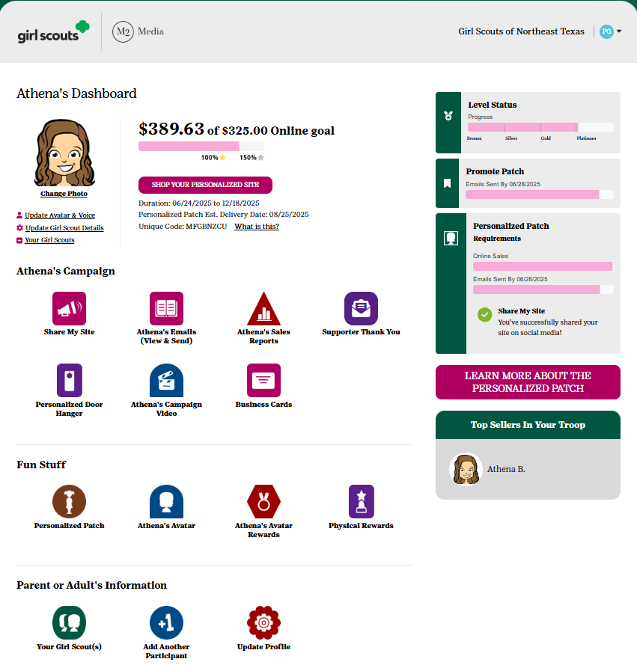
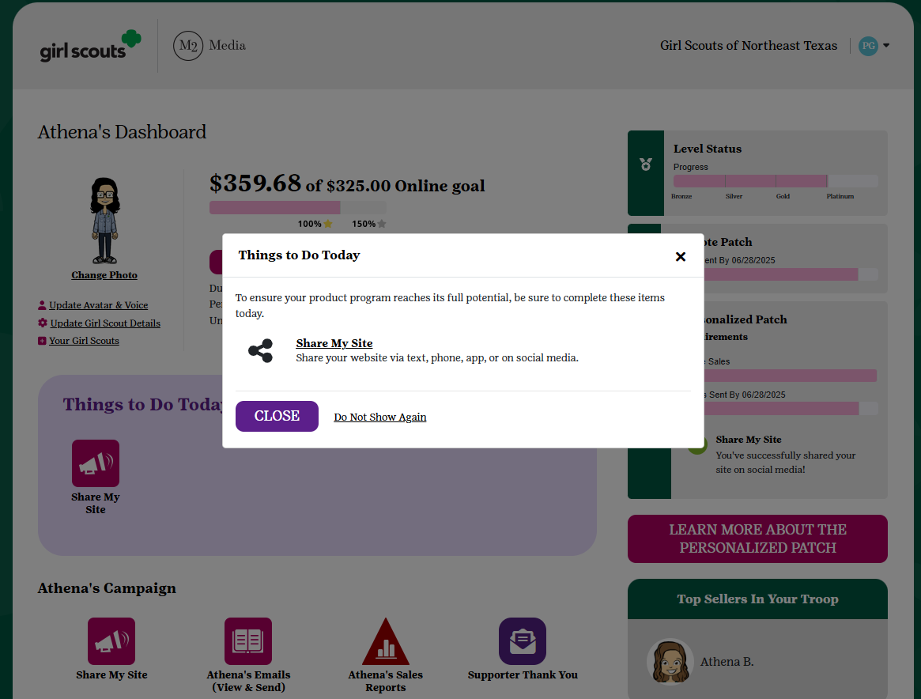
PARTICIPANT’S DASHBOARD
The Dashboard is a Girl Scout’s online toolkit for managing both online and in-person sales!
Find helpful sections such as:
Supporter Thank You
Address Book
Avatar’s Room
Paper Order Entry
Physical Rewards
Sales Reports
Notes:
Recording: "The Participant Dashboard is the central hub for managing both online sales and, if offered by your council, in-person participation. From the dashboard, Girl Scouts can send additional emails, text messages, and social media invitations to supporters, as well as thank-you emails after purchases are made. Throughout the program, Girl Scouts can also visit their Avatar's Room to unlock virtual rewards by completing activities and view their troop photo. On average, participants visit their Avatar's Room four times during the season.
If your council offers paper order cards, parents and caregivers will enter the totals for each item sold before the program ends. Those order card sales are automatically combined with online sales for reporting and reward purposes. Rewards are tracked automatically, and when a reward level includes choices, participants can make their selections directly through the dashboard. The dashboard also includes helpful sales reports by product category, along with detailed reports of Girl Delivered online orders, including supporter contact information to assist with product delivery."

Slide 30
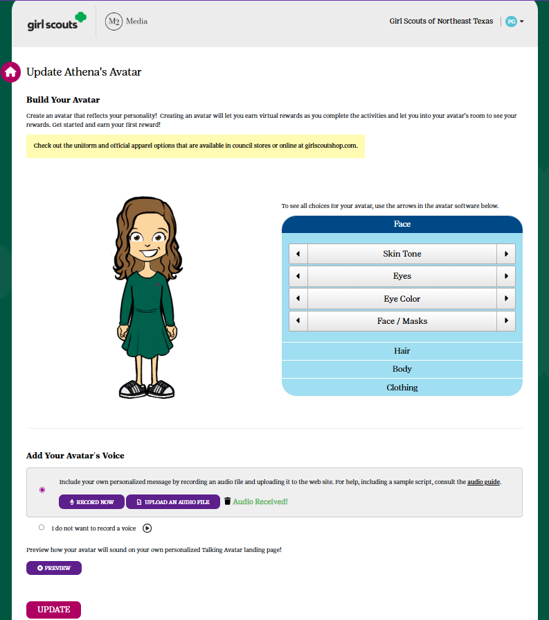





GIRL SCOUT’S PERSONALIZED
EXPERIENCE
Design an Avatar
Notes:
Recording: "Girl Scouts can create a more personal connection with supporters by designing their own digital avatar. Just as they share their personality when selling in person, their avatar helps bring that same experience to the online world.”

Slide 31
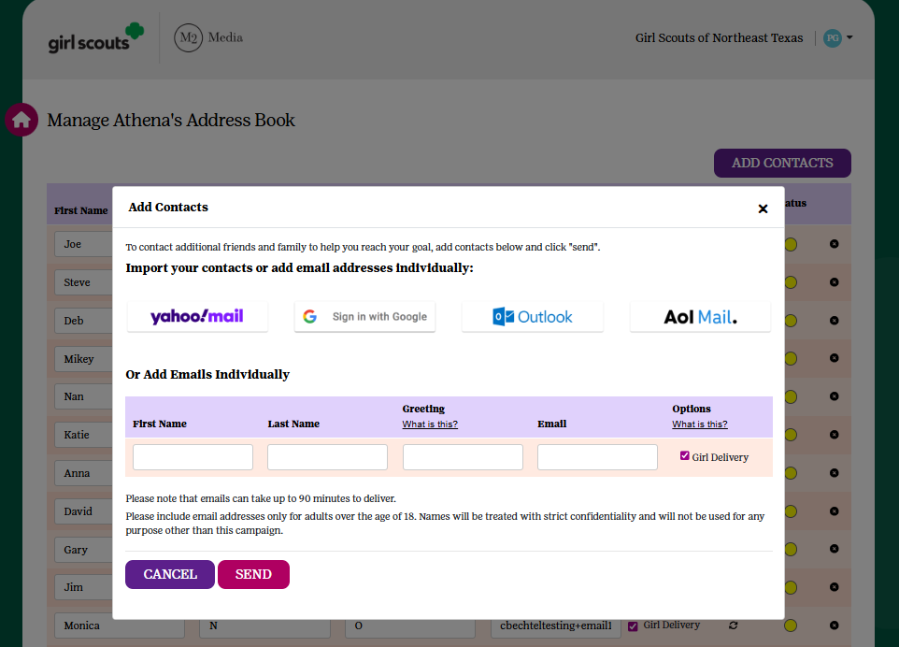
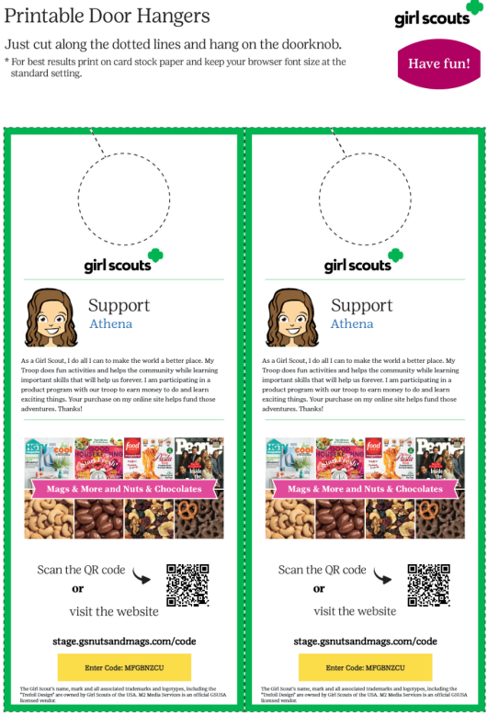
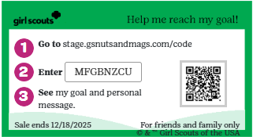
TOOLS TO RUN A BUSINESS
Send emails
Share My Site with social media and texting
Printable business cards
Door hangers with QR codes
Notes:
Recording: "Girl Scouts can personalize each request for support based on how their supporters prefer to connect. Email continues to be the most popular outreach method, generating more than 58% of online sales. Social media is another effective way to reach family and friends, while text messaging makes it easy to share a participant's personalized storefront directly from a smartphone. For in-person interactions, printable business cards and door hangers provide convenient leave-behind materials that make it easy for supporters to shop later."

Slide 32
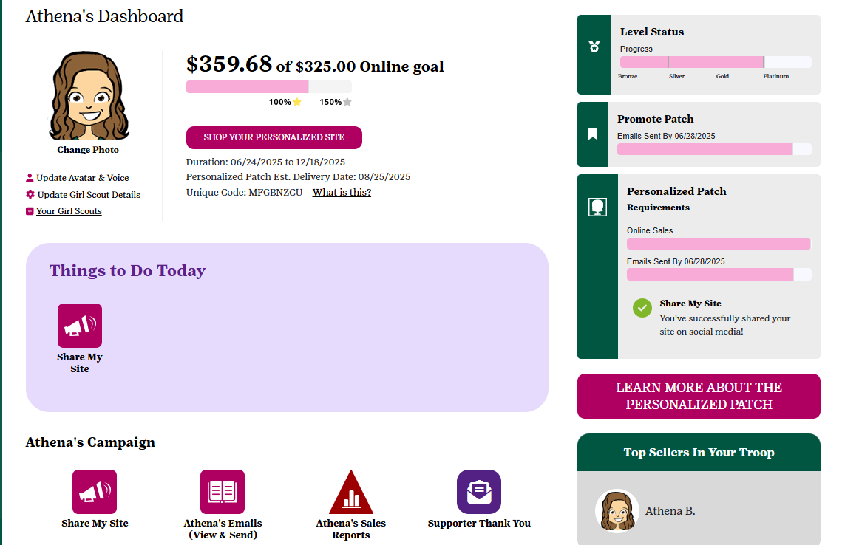
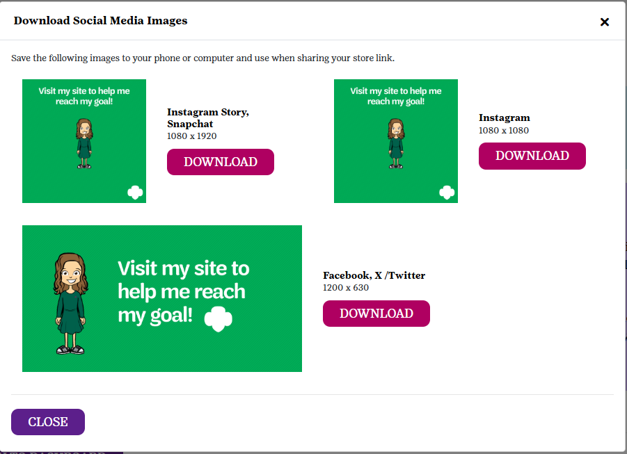
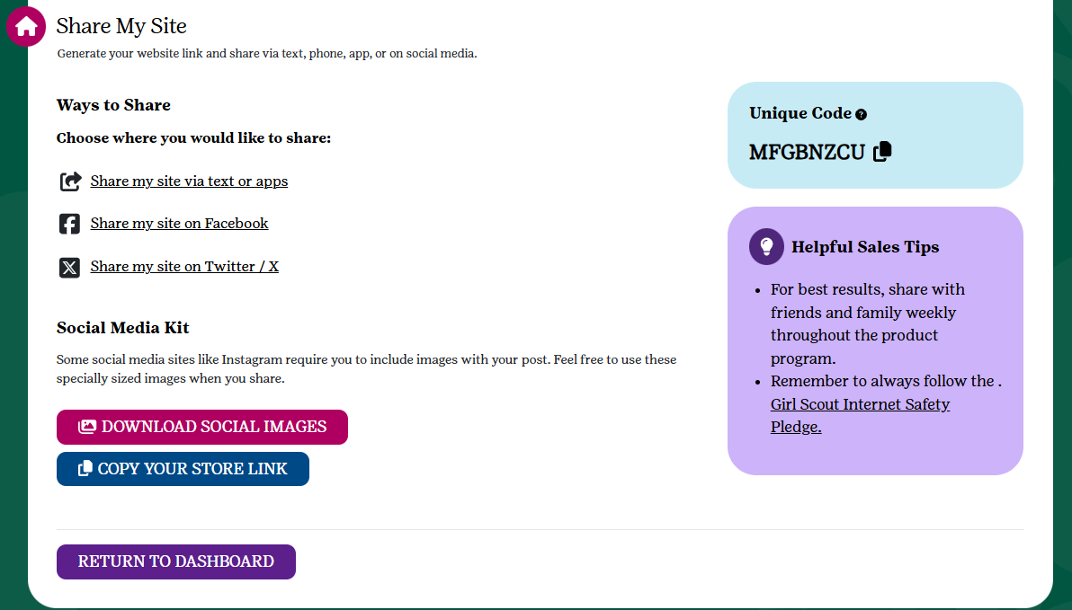
SHARE MY SITE TOOL KIT
Selecting “Share My Site” will bring you to a page allowing for a variety of sharing options!
Download images for additional online marketing
Easily copy the storefront link
Share directly to Social Media
Text friends & family
Notes:
Recording: "Selecting 'Share My Site' from the Participant Dashboard opens a page with everything needed to promote a participant's storefront. From one convenient location, participants can copy their storefront link, share directly to social media, send text messages to friends and family, or download images to use in additional marketing. With all of these resources in one place, sharing their site has never been easier."

Slide 33
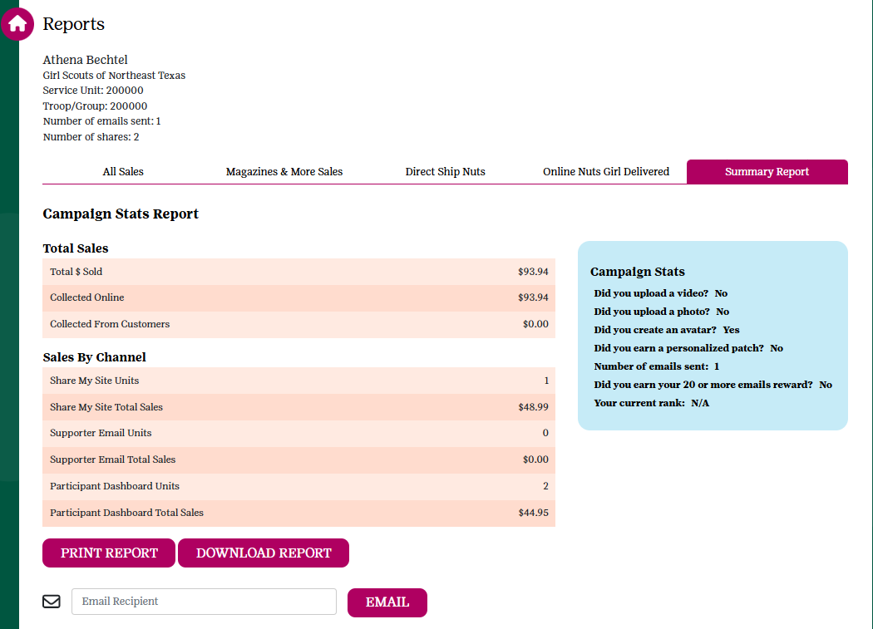
REPORTING
*NEW*
Individual Product line reports have been consolidated for easier viewing. All reporting data still exists, just in easier-to-use sections!
*NEW*
Find additional reporting on Sales by Channel, to allow participants to keep track of how sales originate. Impact results by focusing on under-utilized sales channels!
Earn a 100+ patch for selling $100+ combined dollars or more items via Share My Site!
Notes:
Recording: "We've made reporting easier to navigate this year by consolidating individual product line reports into more streamlined sections. All of the same valuable data is still available, but organized in a more user-friendly format. Participants and volunteers can also access new Sales by Channel reporting, which provides insight into where sales are coming from—whether through email, social media, text, or other channels. This information can help participants identify opportunities to use additional outreach methods and maximize their sales potential."

Slide 34

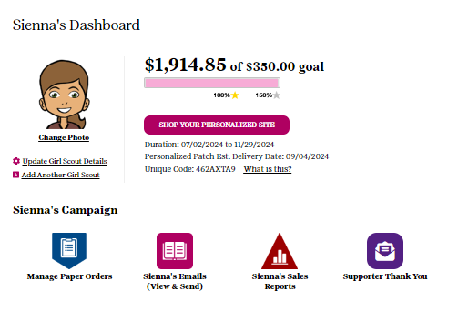
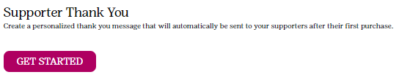
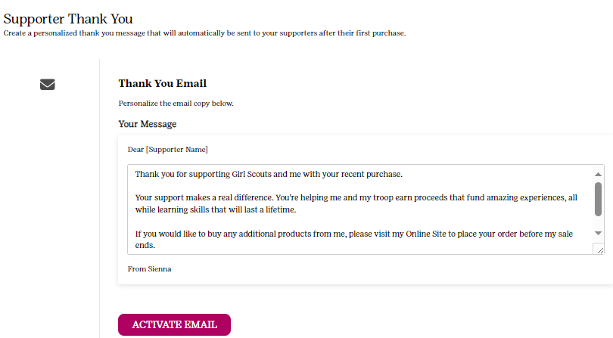
SAY THANKS!
Notes:
Recording: “Girl Scouts can send a personalized “Thank you!” to the supporters who purchase from their online storefronts. Activating the Supporter Thank You email allows participants the opportunity to say, “Thanks for your support!” in their own special way. Accessible from the Girl Scout’s dashboard and can be turned on and off at any time throughout the program.”

Slide 35
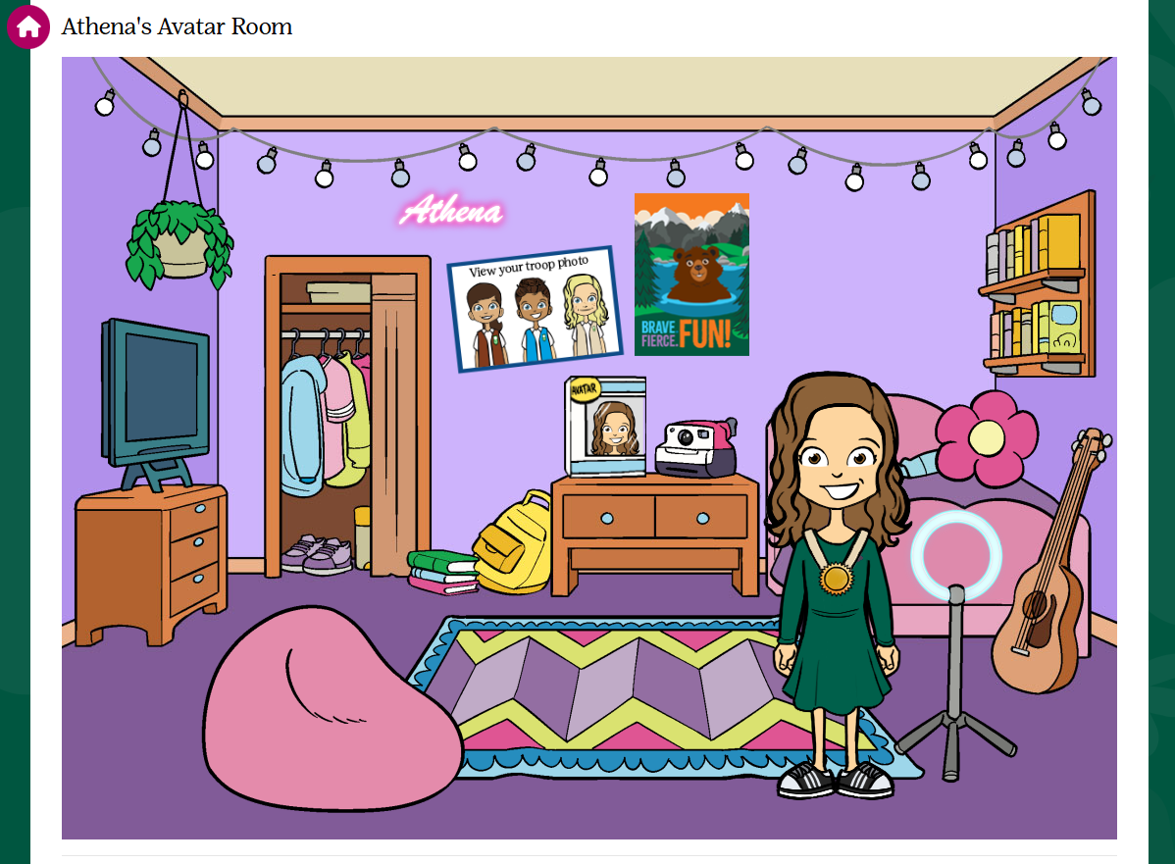

AVATAR ROOM
Unlock cool room accessories when completing tasks
View your troop photo!
Volunteers: be sure to create your avatar, so participants can see you in the Troop Photo!
Notes:
Recording: "The Avatar Room contains virtual rewards to unlock throughout the Fall Product Program. As Girl Scouts complete activities and reach milestones, they can unlock fun room accessories and personalize their virtual space. By clicking on the closet, participants can also update their avatar's outfit and customize their look throughout the program. Be sure to select the Troop Photo on the wall to view all of the cool avatars created by the rest of your Troop!"

Slide 36



Fall Personalized Patch
Personalized Patch – Choose from 3 theme background options!
CRITERIA –
Create your avatar and send 25+ emails
Use the “Share MY Site”
Sell $550+ Combined
Notes:
Recording: “Participants will customize their Personalized Patch by choosing from several adventure-inspired backgrounds—including the Sydney Opera House, Ayers Rock, or the Great Barrier Reef—each featuring our friendly kangaroo mascot. They can then personalize the patch with their name, nickname, or initials. Once the Personalized Patch is earned by meeting the program requirements through a combination of in-person and online sales, it will be shipped directly to the mailing address provided during login."

Slide 37

2026 FALL & COOKIE CROSSOVER PATCH​
​
Participated in the 2026 Cookie Program
&
Participate in the 2026 Fall Program
Notes:
Recording: “Girl Scouts can also earn a Crossover patch during the 2027 Cookie Program that compliments the Personalized Patch. This patch features the 2027 Cookie Program mascot and is earned with the criteria highlighted and directly shipped to the mailing address provided after the cookie program is complete.”

Slide 38







GIRL SCOUT REWARDS
Notes:
Recording: “Girl Scouts can earn theme patches to commemorate the campaign, cute plush that tie-in to the theme and other participant appealing items. Council offered patches and rewards are featured here, online on the M2 platform, and on the nut order card, if one is provided.”

Slide 39
Changes to
Rewards
New Opt-out Options
Booth requirement increased due to sales included for full program dates
  $2,000
New 2nd Exclusive Booth Opportunity
  Troops who have at least 3 girls selling with a PGA of $250 combined dollars sold

Slide 40
END OF MODULE #2
(QUESTIONS FOR GSLEARN)
1.Which of the following ways can participants access the M2 platform?
A. Custom link on council’s website
B. General internet search for “Girl Scouts”
C. Launch email sent to parent/adult email’s address on “go day”
D. Visit M2’s website and click on the company’s link
2.TRUE OR FALSE – Participants have the ability to select which supporters receive an invitation to order online with girl delivered (customers pay online and the Girl Scout delivers).
3.TRUE OR FALSE – Girl Scouts earn the personalized avatar patch by creating an avatar, sending 18+ emails, using the “Share My Site” tool and reaching $300 in total sales.
4.”Share My Site” provides the following tools to Girl Scouts:
A. Texting
B. Facebook posting
C. Posting on X
D. Instagram

Slide 41
Volunteer Experience
Notes:
Recording: “So far, the focus has been on the purpose, products and participant experience associated with the Product Program. Now we will transition to the troop volunteer experience and the tools available to you as you come alongside Girl Scouts through their Girl Scout Leadership experience.”

Slide 42


TROOP VOLUNTEER ACCESS
Receive an email invitation to login
Watch Troop training video
Queue Parent/Adult Email Campaign
Create your volunteer avatar
42
Notes:
Recording: "M2 is a management toolkit designed to provide troops with the resources and tools they need to help participants have a successful Fall Product Program experience. Approximately one week before the program begins—or when your council provides access—troops will receive an invitation to log in to the Admin site. Once logged in, troop volunteers will view a short training video that provides an overview of the program and introduces the key features of the M2 platform.
After completing the initial training, troops can access additional platform guidance directly within M2 to walk them through the next steps. Troops can then launch the Parent/Adult Email Campaign, which helps announce their participation and provides families with the information and links they need to get started. Throughout the program, encourage troop volunteers to create their own troop avatar and explore the tools available to support their Girl Scouts."

Slide 43

PARENT/ADULT EMAIL CAMPAIGN
Participant details and email addresses are uploaded by council
Edit or enter missing parent/adult emails
Select “Send and Continue” to Proceed – an email with instructions on how to participate will be sent to each Parent/Adult on the Campaign Launch Date
Notes:
Recording: "After completing the troop training video, volunteers will be prompted to send the Parent/Adult Email Campaign. Sending this campaign is required before they can continue setting up their troop profile. Parent and adult email addresses will be uploaded by the council, so troops simply need to review the list, confirm the information is accurate, and make sure all Girl Scouts in the troop are included. Before sending, volunteers can add or update any information as needed. Once sent, the Parent/Adult Email Campaign provides families with the information they need to get started with the program."

Slide 44

TROOP DASHBOARD
Send Messages
Manage Paper Order entry
Select rewards
View sales reports
Banking and payments
Notes:
Recording: “Troop leaders and product program managers can view overall troop stats on the landing page of the volunteer admin site, as well as manage the program. Troops have the ability to send messages to participants within the troop to encourage participation, share Program updates, and thank them at the conclusion of the Program. Troops also have the ability to edit or enter participant order card items if your council participates with the nut order card. Rewards and personalized patches that Girl Scouts have earned will appear in the site. Troops should check to make sure they are correct, make any missing selections of items so rewards can be submitted, and enter addresses where necessary for patches to be fulfilled. Troop level reports are available showing total sales and a break down by channel and product. The Troop Summary Report is a great overview of the key troop financials including troop proceeds and balance due to council. Banking and Payments provides troops with a view into bank transactions and council payments and gives troops an optional tool to track participant payments if entered by the troop.
Troop volunteers can login to see reports and banking information throughout the duration of the Girl Scout year.”

Slide 45





CREATE YOUR VOLUNTEER AVATAR
Choose from a wide selection of volunteer-specific avatar options to create your likeness!
Participants will be able to view your avatar in their Troop Photo
Notes:
Recording: "Be sure to create your troop volunteer avatar as part of your program setup! You’ll have a variety of volunteer-specific options to choose from so you can create an avatar that represents you. Your avatar will be featured in your troop photo alongside your Girl Scouts, adding a fun and personalized element to the program experience."

Slide 46



TROOP VOLUNTEER REWARDS
Send Parent/Guardian Email Blast
&
$1,750 in Troop Combined dollars sold
Notes:
Recording: "Another great reason to create your troop volunteer avatar is that troop volunteers can also earn their own Personalized Patch! Be sure to complete the required steps to qualify for this special recognition. More details about how to earn the Personalized Patch are included in this section."

Slide 47

DELIVERY TICKETS
Print delivery tickets by Service Unit or troop
Available for easier picking and packing
Option to include financials
Delivery tickets will be available for both nut & chocolate products and rewards.
Notes:
Recording: "Detailed reports are available under the Reports section in M2, as well as through the Delivery Tickets link. The Delivery Tickets link will become available to volunteers after the council submits the initial nut and chocolate order to the nut company. Once available, volunteers can print product and reward delivery tickets for their Service Unit or troops directly from the platform to make picking and packing easier.
Product delivery tickets include the items needed for distribution, but please note they will not include any late or additional product orders submitted after the initial order. There is also an option to include financial information by troop; however, if your council continues to accept online sales after the in-person order-taking phase, this information will not reflect those additional online sales. For the most current troop financial information, refer to the Banking and Payments section or the Reports section within M2."

Slide 48


BALANCING FINANCES
Sales reports
Troop Summary Report
Banking and payments
Notes:
Recording: “Service Unit and troop level reports are available by total sales and product category with the Troop Summary Report being a great overview of key troop financials including troop proceeds and balance due council. Banking and Payments provides troops with a view into bank transactions and council payments and gives troops an optional tool to track participant payments if entered by the troop.”

Slide 49
Program Specifics
Notes:
Recording: “Now, let’s discuss your Council’s program specifics!”

Slide 50
IMPORTANT DATES
Sept. 24th
Volunteer Access to M2
Oct. 26th
Girl delivered online order taking ends
Oct 28th
Last day for parents to enter paper orders in M2
Nov. 1st
Last day for troops to enter paper orders in M2 for Girl Scouts
Nov. 1st
Last day for SUs to enter paper orders in M2
Nov. 15th
Online orders for Direct Ship ends
Nov. 14th– 21st
SU Nut Deliveries
Oct. 1st
Oct. 5th/6th
Fall Program begins / Parent access to M2
Virtual Avatar Building Party
Nov. 17th
Girls Choose final rewards
Nov. 22nd
T17s Due
Dec. 3rd
ACH
Start date has been changed back to 10/1 start date.
Online only portion of program has been shortened by two weeks.
Notes:
Recording: “Important dates for the Program are found here and can also be found in your troop and/or Service Unit guides and on the council website.”

Slide 51
FAQs
How do I reset my password?
When can a supporter expect a direct ship nut order placed online?
When will a participant receive their Personalized Patch?
What if a participant didn’t find their name as they log into the platform?
When can I expect my online girl delivery items?
Notes:
Recording:
“1.From the login page, click the Forgot Your Password link. Remember that if you are also a parent, you must log into the participant section to manage your Girl Scout’s account. If you are also the troop/SU manager, you will need to login to the admin site. You can set up each site to use the same login and password for both!
2.The supporter will receive a confirmation email of the order and then another email when the order ships with tracking details.
3.The personalized patch will arrive about 8 to 10 weeks after being sent to the patch company for production. On the participant dashboard, you will see an ETA date so you can anticipate when your patch should arrive.
4.That’s not a problem! Any Girl Scout who doesn’t know their troop number or see their name, can add themselves to the system. After a participant sets up an account, there will be a brief delay while the council confirms their GSUSA membership. Once that task is completed, council will release the participant from the holding tank and their customers will then have access to make purchases.
5.Because timelines may vary, please have customers inquiring about their online girl delivered items reach out directly to the Girl Scout from whom they purchased for more details.”

Slide 52

FALL PRODUCT PROGRAM CUSTOMER CARE
M2’S Customer Care team is cross-trained to handle tech support, volunteer/participant and customer inquiries
Support available through phone, chat, and email!
100% customer satisfaction guarantee
Notes:
Recording: "As you support your Girl Scouts throughout the Product Program, remember that help is always available when you need it. M2’s Customer Care team is cross-trained to assist with volunteer, participant, and customer questions, providing support throughout the program experience. If a question comes up that you’re unable to answer, please direct families, participants, and supporters to the Customer Care team for assistance.

Slide 53

THANK YOU!
For your continued support of Girl Scouting and the Fall Product Program.
We look forward to a successful 2026 Program!
Notes:
Recording: “Thank you for the time, energy, and commitment you put into making the Product Program a successful and meaningful experience for Girl Scouts. Your support helps Girl Scouts build confidence, develop new skills, and reach their goals! We wish you a successful 2026.”

